Slide 1

Smart Investment prediction
TEAM NAME:
MIND BENDERS
TEAM MEMBERS:
B.DIVYA
S.V.V.ANKI REDDY
K.DILLI
L.POOJA
K.PRATHYUSHA

Slide 2

Synopsis:
*Introduction to 'Smart Investment'
*Aim of the project
*Decision Tree Regression
*Data set
*Accuracy
*Node Red
*Conclusion

Slide 3


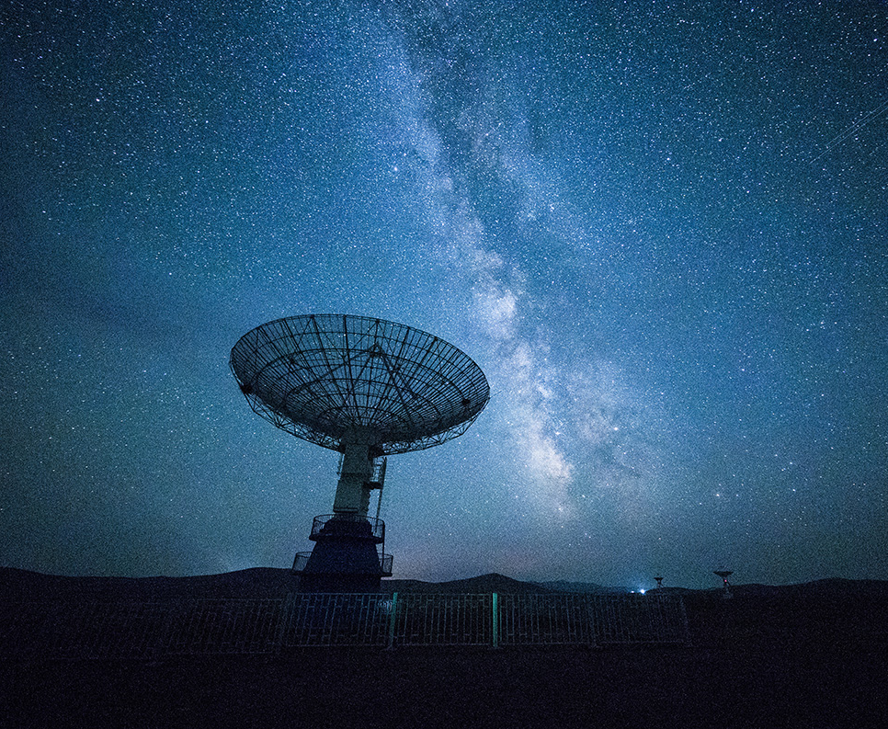
Smart investment
Shares
Bonds
Debentures
Mutual Funds
Life Insurance
Bank Deposits
Real Estate
PPF

Slide 4
Aim of the project
Problem :
If we invest in a particular company, we cannot predict whether it may leads to profit or it may leads to loss in future?
Can we predict the future investment returns manually?
Solution :
We can able to resolve this problem by checking the historic data of particular company and by using Machine Leaning models, such as Decision Tree Regressor.

Slide 5
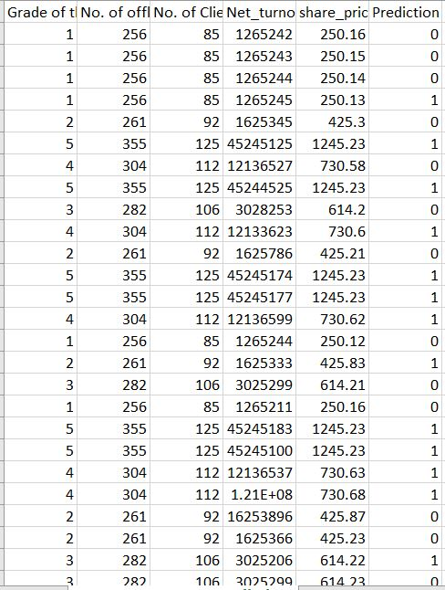
Data set
Attributes:
1.grade of the company
2.No. of offline projects
3.No. of client projects
4.Net Turnover
5. Share Price
6.Prediction

Slide 6
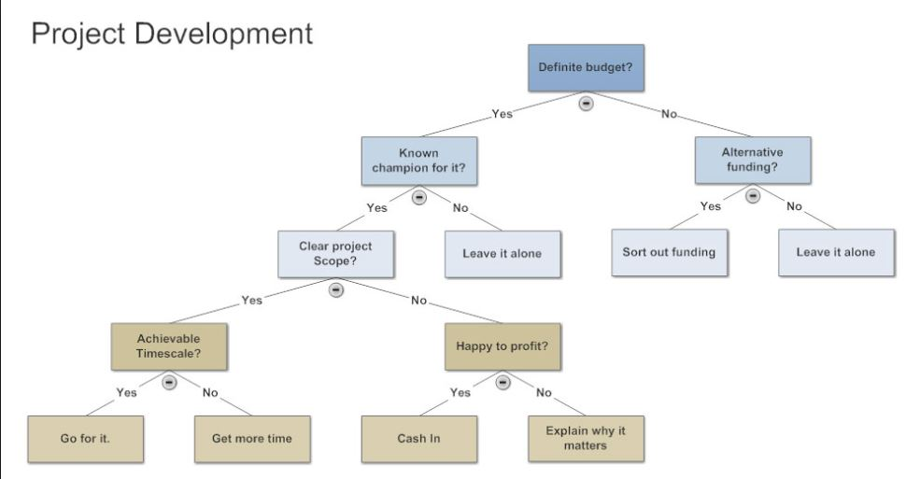
Decision tree regression:
Model Explanation:
Decision Tree is a decision-making tool that uses a flowchart-like tree structure or is a model of decisions and all of their possible results, including outcomes, input costs and utility.
Decision-tree algorithm falls under the category of supervised learning algorithms.

Slide 7
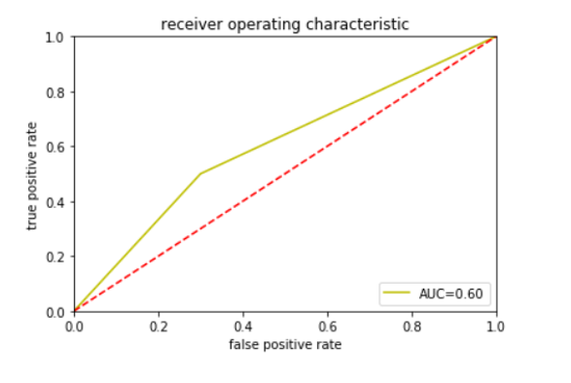
accuracy
Type = Regression
Model =Decision Tree Regression
AUC= Upper Curve(yellow color)
ROC=Lower Curve(red color)
FPR(False Positive Rate),
TPR(True Positive Rate).

Slide 8

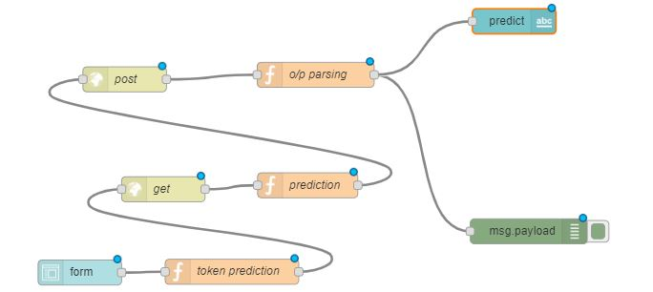
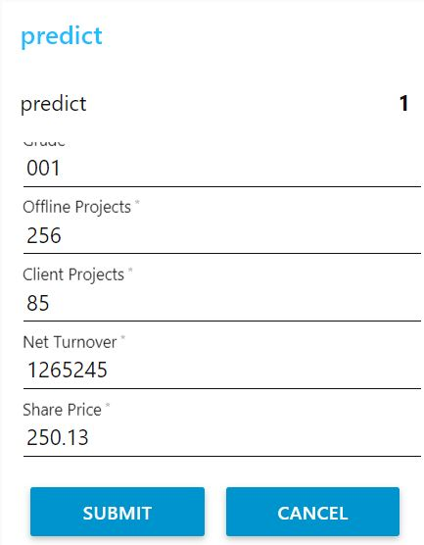
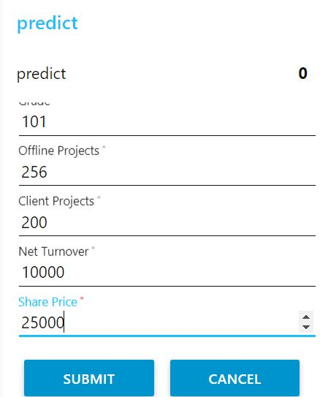
NOde red ====>
Form
Token generation
Get
Prediction
Post
o/p parsing
Predict
Msg.payload

Slide 9


conclusion
Finally ,we conclude that decision tree regressor is the best machine learning algorithm to resolve the problem named as "smart investment prediction"

Slide 10

Any questions ?

Slide 11


Thank You!
-Mind benders

